Slide 1


Random Forest For Regression and Classification
Kareem Ameerah​

Slide 2

Agenda
Definition of Terms
Introduction To Random Forest
Random Forest For Regression
Steps Involved in Random Forest Regression
Random Forest For Classification
Steps Involved in Random Forest Regression
Advantages and Disadvantages of Random Forest
Final tips & takeaways

Slide 3
Definition Of Terms
Bootstrapping
It refers to the process of creating multiple subsets of the training data by randomly sampling with replacement from the original dataset. This means that each decision tree in the forest is trained on a slightly different subset of the data.
Imagine you have a large dataset of 1000 samples. To train a single decision tree, you would typically use the entire dataset. However, in Random Forest, you would create a subset of, say, 800 samples by randomly selecting from the original 1000 samples. This subset is called a bootstrap sample.
Bootstrapping helps to:
i. Reduce overfitting: By training each tree on a slightly different subset of the data, the forest as a whole becomes less sensitive to the training data.
ii. Increase diversity: Bootstrapping introduces randomness, which leads to a more diverse set of decision trees, ultimately improving the overall performance of the forest.

Slide 4
Random Feature Selection
Random feature selection is another crucial aspect of Random Forest. When training a decision tree, you typically consider all the features (or variables) in the dataset. However, in Random Forest, each decision tree is trained on a random subset of the features.
The random feature selection process is repeated for each decision tree, which means that each tree is trained on a different subset of features.
This process helps to:
Reduce correlation: By selecting a random subset of features, the trees become less correlated, which improves the overall performance of the forest.
Increase robustness: Random feature selection makes the forest more robust to noisy or irrelevant features.

Slide 5

Introduction To Random Forest

Slide 6
What Is Random Forest
Random Forest is a type of supervised learning algorithm that combines multiple decision trees to improve the accuracy and robustness of predictions. It works by training multiple decision trees on random subsets of the data and then combining their predictions to produce a final output.
Random Forest: It is a collection of multiple random decision trees and it is much less sensitive to the training data. You can guess that we use multiple trees hence the name forest. Why is it called random? It is because we have used 2 random processes, bootstrapping and random feature selection.

Slide 7
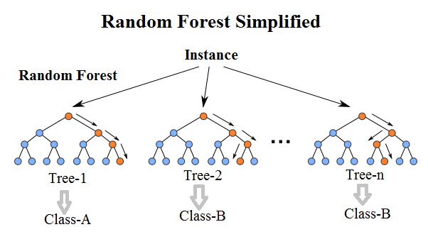
Random Forest
This Photo by Unknown Author is licensed under CC BY

Slide 8

Random Forest For Regression

Slide 9
Random Forest For Regression
In regression tasks, the goal is to predict a continuous output variable. Random Forest regression works by training multiple decision trees on random subsets of the data and then combining their predictions to produce a final output. The final output is typically the average of the predictions from each tree.
Here are the steps involved in Random Forest regression:
Bootstrap sampling: A random subset of the data is selected with replacement to train each decision tree.
Decision tree training: A decision tree is trained on the random subset of data.
Prediction: Each decision tree predicts the output value for a given input.
Combining predictions: The predictions from each tree are combined to produce a final output.

Slide 10
Random Forest For Classification
Common Applications of Random Forest Regression
Random Forest regression has numerous applications in various fields, including:
Predicting Continuous Outcomes: Random Forest Regression is widely used in predicting continuous outcomes such as stock prices, temperatures, energy consumption, and more.
2. Energy Load Forecasting: Random Forest Regression is used to forecast energy load demand, which helps in optimizing energy production and reducing waste.
3. Real Estate Price Prediction: Random Forest Regression is used to predict real estate prices based on features such as location, size, and amenities.
4. Credit Risk Assessment: Random Forest Regression is used to assess credit risk by predicting the probability of default based on credit scores, income, and other factors.
5. Customer Churn Prediction: Random Forest Regression is used to predict customer churn by analyzing customer behavior, usage patterns, and other factors.

Slide 11
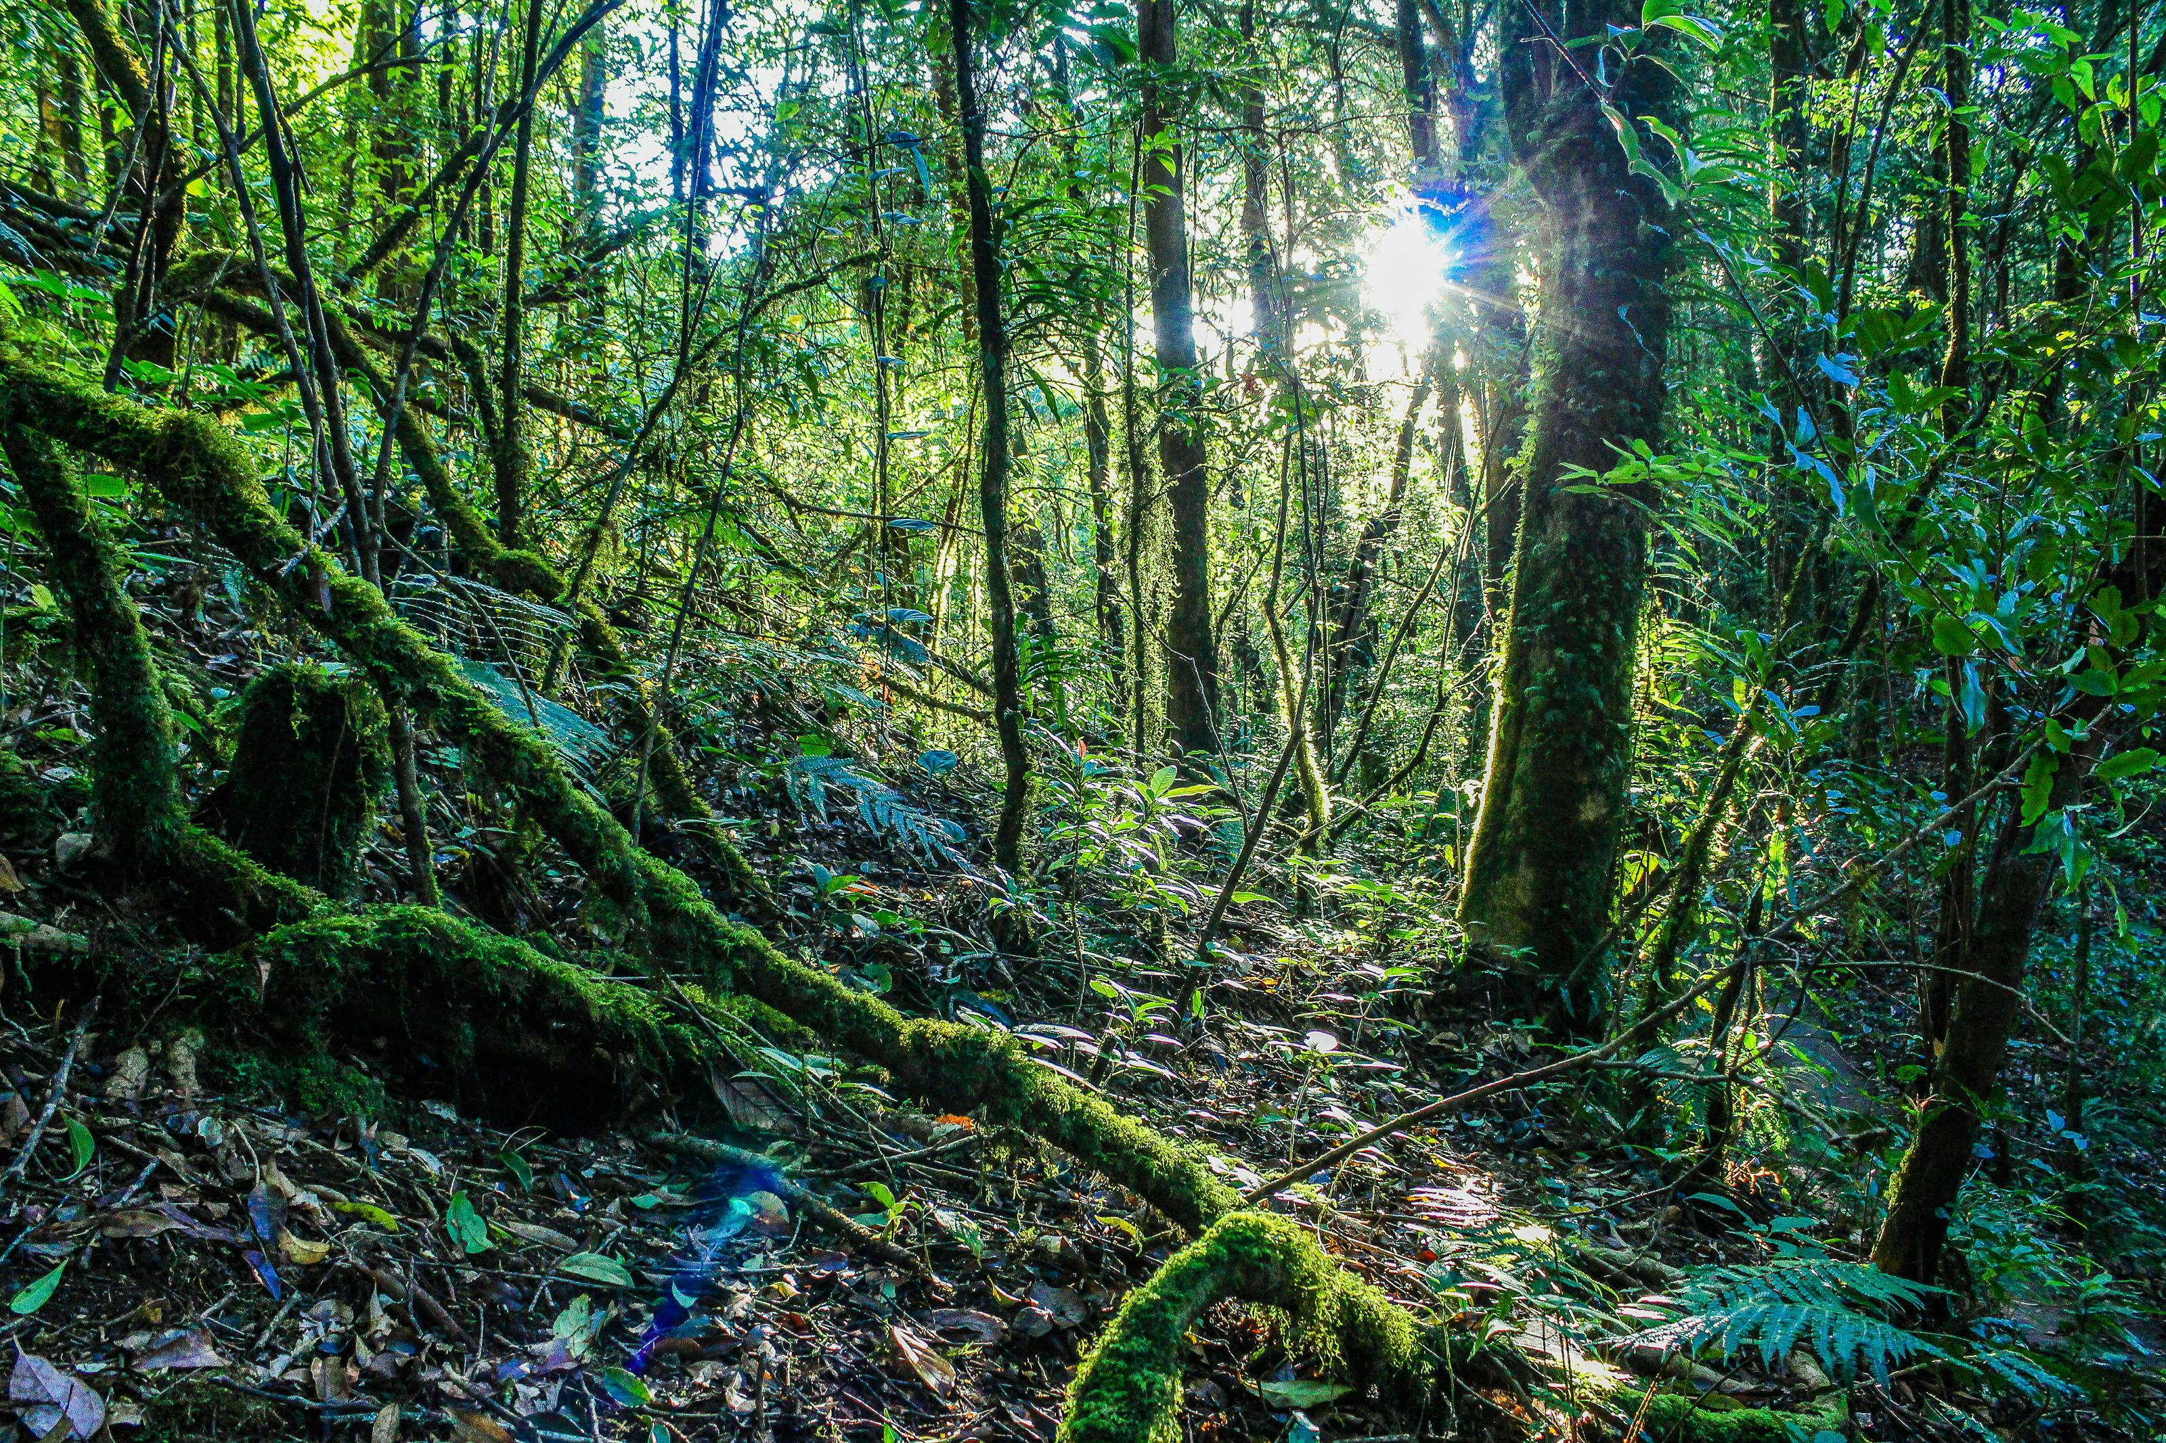
Random Forest For Classification

Slide 12
Random Forest For Classification
In classification tasks, the goal is to predict a categorical output variable. Random Forest classification works similarly to regression, but the final output is typically the class label with the highest vote from each tree.
Here are the steps involved in Random Forest classification:
Data Prep: Prepare data.
Bootstrap: Sample data with replacement.
Tree Creation: Create decision trees on samples.
Random Feature Selection: Select random features for each tree.
Tree Voting: Each tree predicts class label.
Final Prediction: Choose class label with most votes.
Forest Creation: Combine multiple trees to create fore

Slide 13
Tree Voting
So, imagine we have all decided to order something to eat in class. Each person has an idea of what we should order, and they tell you their choice.
In Random Forest, each person is like a special kind of computer program called a "decision tree". Each decision tree looks at the data (like the different restaurants/vendors on glovo) and makes a guess about what we should order.
But, instead of just listening to one person, we ask everyone in class (all the decision trees) what they think we should order. And then, we count how many friends said each vendor/restaurant.
The vendor/restaurant that the most people mention is the one we would order from! That's like the final prediction.
For example, let's say we have 5 people in our data science class (decision trees), and they all say:
Dami: “The Place"
Emeka: “Sweet Sensation"
Mr. Obinna: " The Place"
Zion: “Dodo Pizza"
Folarin: " The Place"
We count the votes, and we see that 3 people said " The Place!, 1 person said “Sweet sensation “ and the last person said “Dodo Pizza”. So, we choose to order from The Place
That's basically how Tree Voting works in Random Forest!

Slide 14
Random Forest For Classification
Common Applications of Random Forest Classification
Random Forest classification has numerous applications in various fields, including:
Image Classification: Random Forest can be used for image classification tasks, such as object detection and facial recognition.
Text Classification: Random Forest can be used for text classification tasks, such as sentiment analysis and spam detection.
Bioinformatics: Random Forest can be used for bioinformatics tasks, such as protein function prediction and gene expression analysis.
Finance: Random Forest can be used for finance tasks, such as credit risk assessment and stock market prediction.

Slide 15
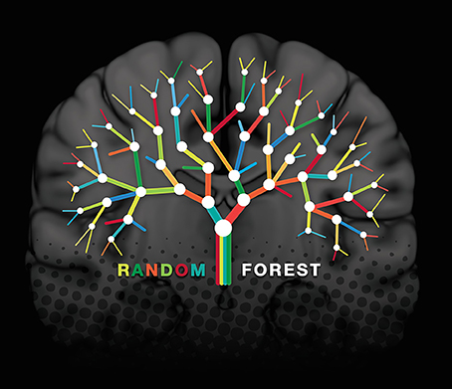
Advantages Vs Disadvantages
ADVANTAGES
Handling High-Dimensional Data: Random Forest can handle high-dimensional data with a large number of features.
Handling Missing Values: Random Forest can handle missing values in the data.
Robust to Outliers: Random Forest is robust to outliers in the data.
Improved Accuracy: Random Forest can provide improved accuracy compared to individual decision trees.
Handling Non-Linear Relationships: Random Forest can handle non-linear relationships between features.
Feature Importance: Random Forest provides feature importance, which can be used for feature selection.
Parallelization: Random Forest can be parallelized, making it computationally efficient.
Handling Class Imbalance: Random Forest can handle class imbalance problems.
DISADVANTAGES
Computational Complexity: Random Forest can be computationally expensive, especially for large datasets.
Overfitting: Random Forest can suffer from overfitting if the number of trees is too large.
Difficult to Interpret: Random Forest can be difficult to interpret, especially for non-technical stakeholders.
Not Suitable for Small Datasets: Random Forest may not be suitable for small datasets, as it can be biased towards the majority class.
Hyperparameter Tuning: Random Forest requires hyperparameter tuning, which can be time-consuming.
Not Suitable for Real-Time Systems: Random Forest may not be suitable for real-time systems, as it can be computationally expensive.
This Photo by Unknown Author is licensed under CC BY

Slide 16
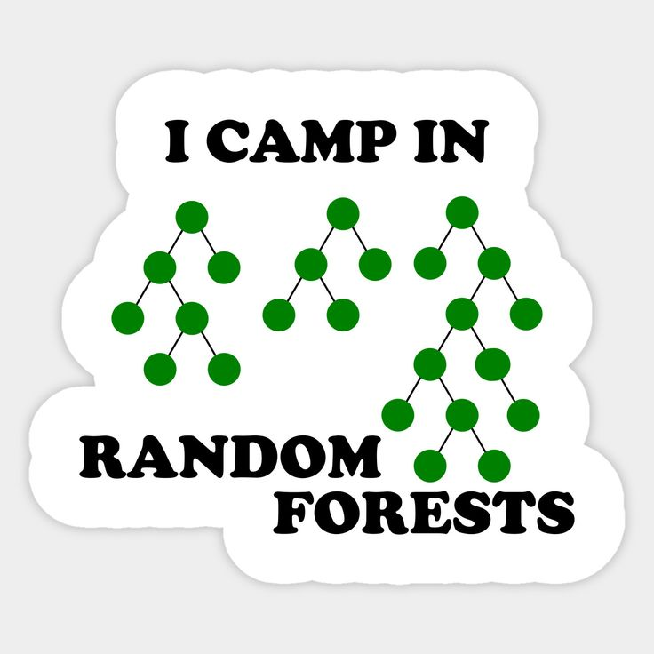
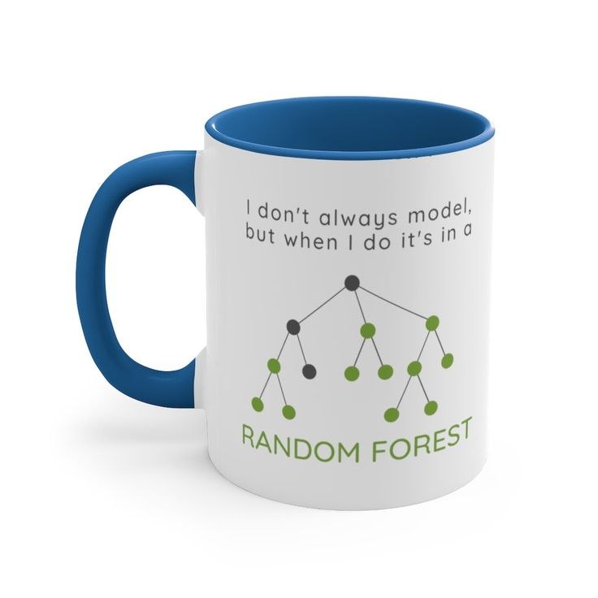
BANTER

Slide 17


